Slide 1

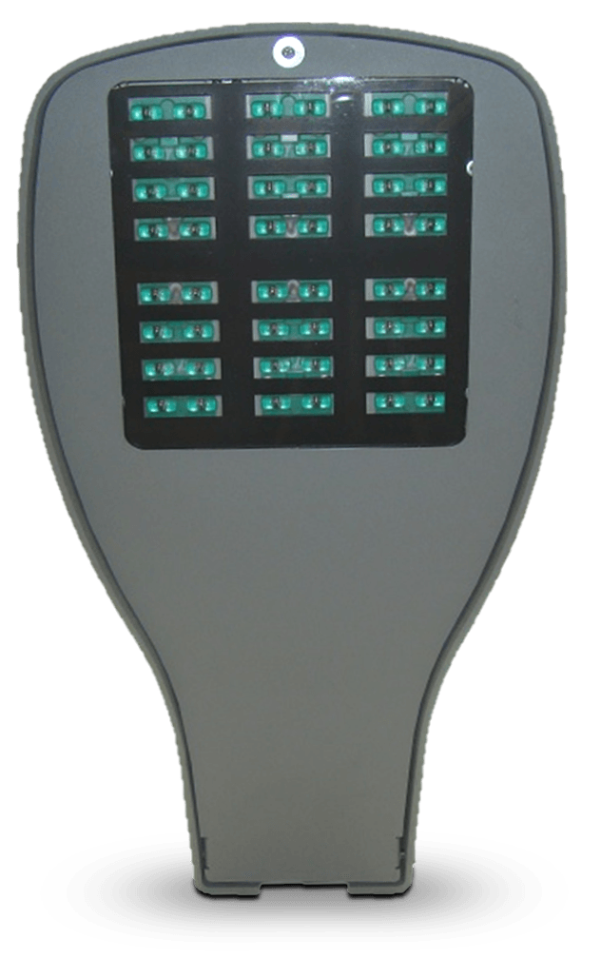

ASTROPHILE SERIES
NARROW BAND AMBER LED LUMINAIRES

Slide 2
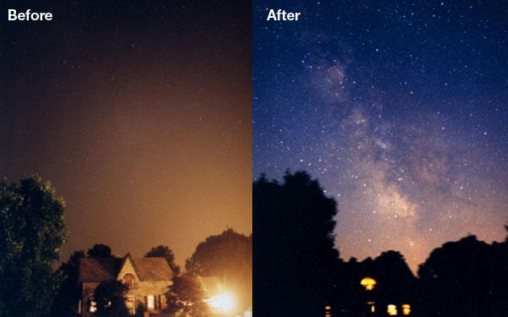
Before and after photos during a power outage that illustrates the issues associated with light pollution and sky glow
THE PROBLEM - WHAT IS LIGHT POLLUTION?
Light pollution is the introduction of artificial light into the night sky
Artificial lighting is the primary cause of sky glow, obscuring the stars and creating perpetual twilight
Light pollution contributes to light trespass issues on public and private properties
Today, 80% of the United States population cannot see the Milky Way

Slide 3
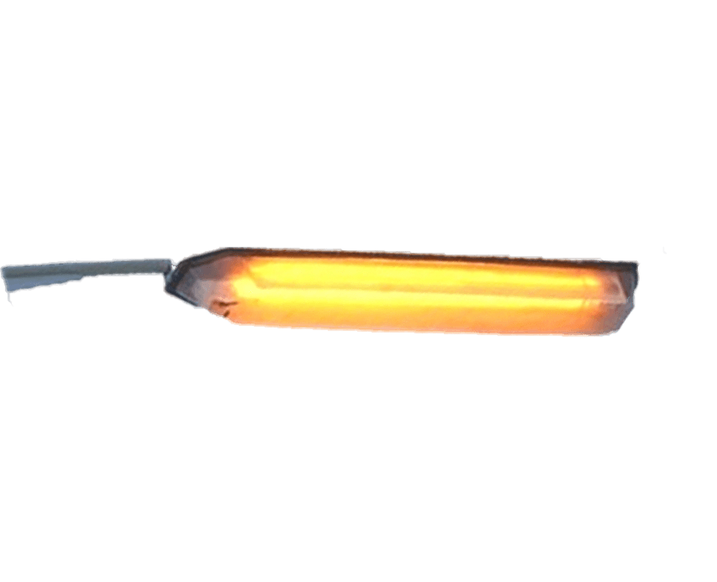
THE PROBLEM - OBSOLETE LIGHTING TECHNOLOGY
Low Pressure Sodium (LPS) fixtures were an excellent choice for cities, observatories and environmentally sensitive areas that require Dark Sky compliant lighting.
LPS fixtures have become obsolete and replacement parts are expensive and difficult to obtain

Slide 4
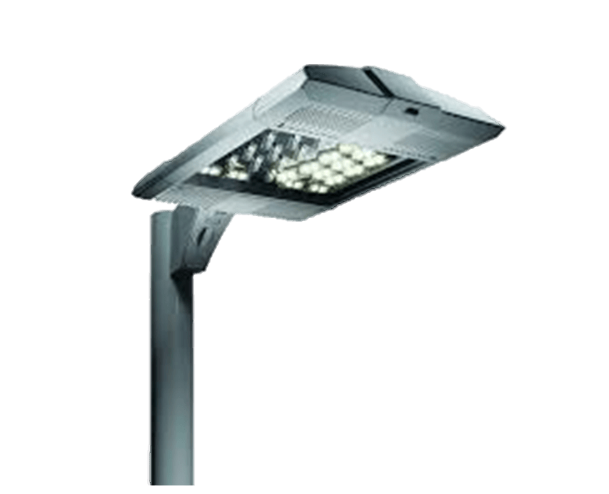

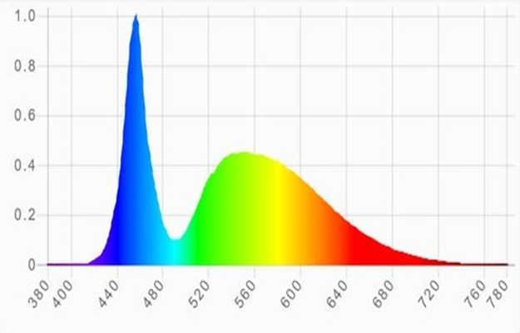
THE PROBLEM - MOST LED LUMINAIRES ARE NOT DARK SKY COMPLIANT
Most LED luminaires are not Dark Sky Compliant
White LED’s produce a significant amount of blue light
Blue light scatters in the atmosphere, obscuring the view of stars from the ground and contributing to light pollution and sky glow
When compared to existing HPS and LPS fixtures, most LED street lights increase light pollution and sky glow anywhere from 170% to over 500%
Externally mounted light shields offer no protection against light pollution

Slide 5
THE CROSSROADS LED
SOLUTION
American-made LED luminaires designed specifically for Dark Sky lighting applications.

Slide 6
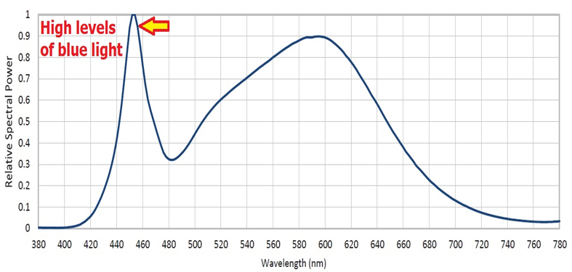
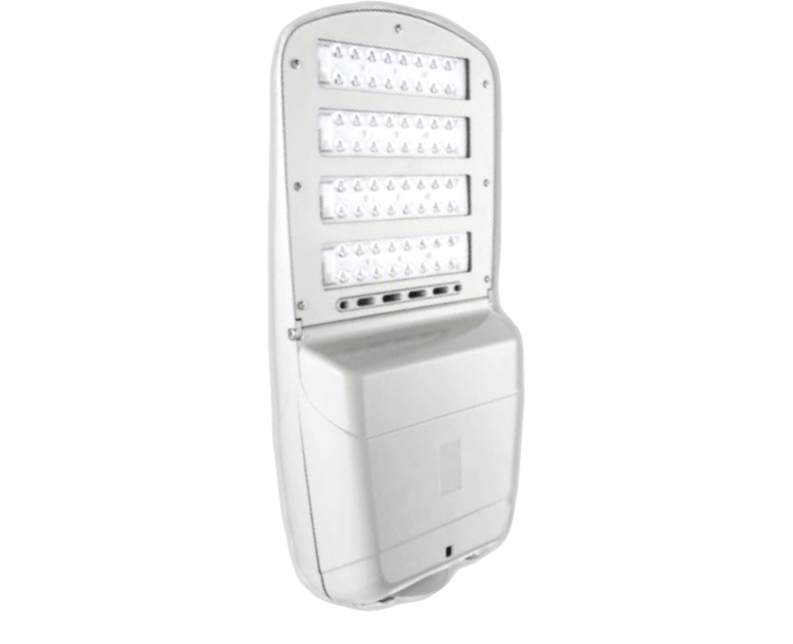
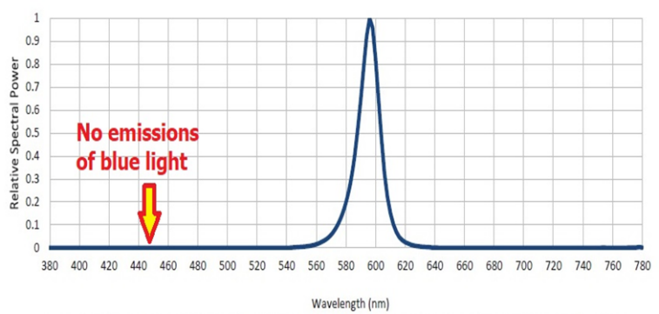
DARK SKY COMPATIBLE SOLUTIONS
TYPICAL LED ROADWAY FIXTURE
Spectral Power Distribution (SPD) Measurement
CROSSROADS LED ASTROPHILE FIXTURES
Spectral Power Distribution (SPD) Measurement

Slide 7
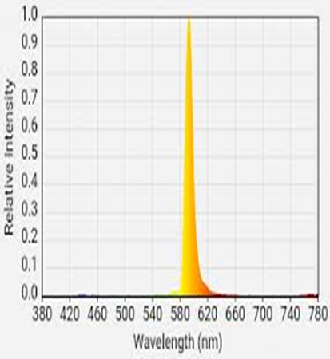
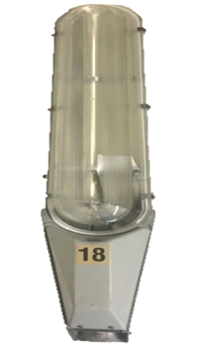
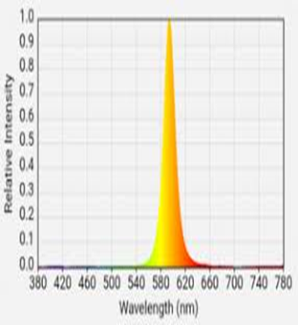
DARK SKY COMPATIBLE SOLUTIONS
Peak dominant wavelength of low-pressure sodium lamps
Peak dominant wavelength of Crossroads LED Narrow Band Amber Astrophile Series fixtures

Slide 8
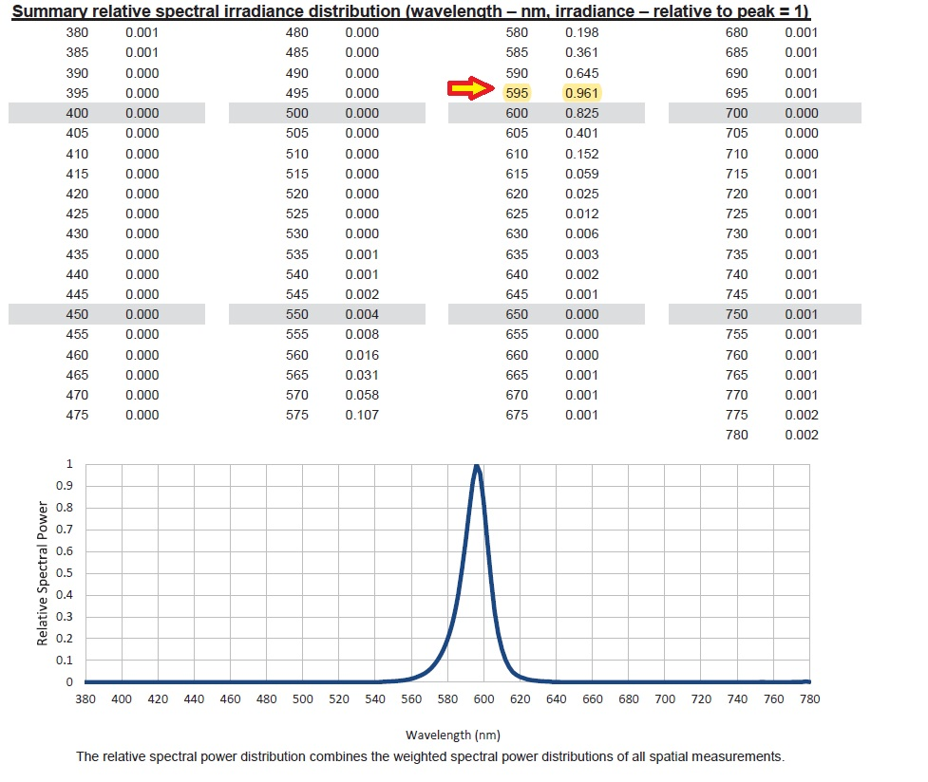
KEY BENEFITS
Independent photometric testing verifies the Astrophiles Series peak dominant wavelength

Slide 9
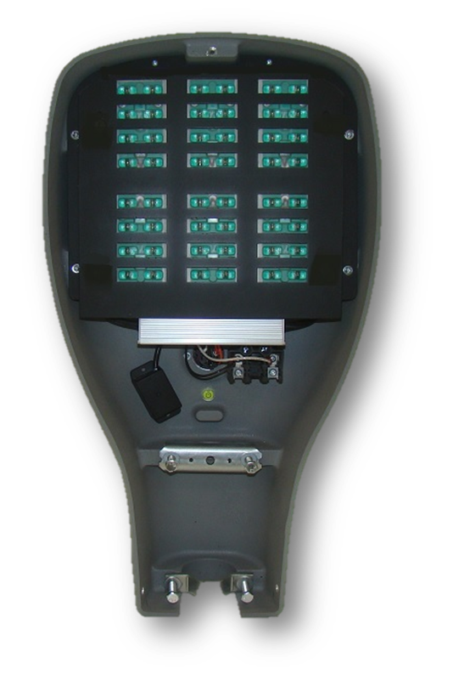
KEY BENEFITS
Modular and flexible design is future-proof. All components, including the Narrow Band Amber (NBA) LED modules and power supplies are both field replaceable and upgradable
Fully integrated and adjustable internal house side shielding completely eliminates light trespass issues
Fully recessed NBA LED modules eliminate up-light and glare
Adjustable lumen output from 2,000 to 7,000 lumens
NBA LED’s available in 589nm, 592nm, and 595nm
Available in type I, II, III, IV, and V distribution patterns
Proprietary, advanced two-stage thermal management system ensures low LED die temperatures, guarantees years of reliability and long life
L70 rating of 85,000hrs (19.40 years)
Standard 7 pin ANSI photo cell socket is compatible with all electronic lighting controls
Easily accessible internal bubble level
Patented, proven and reliable technology (Patent number: US 9,964,288)

Slide 10
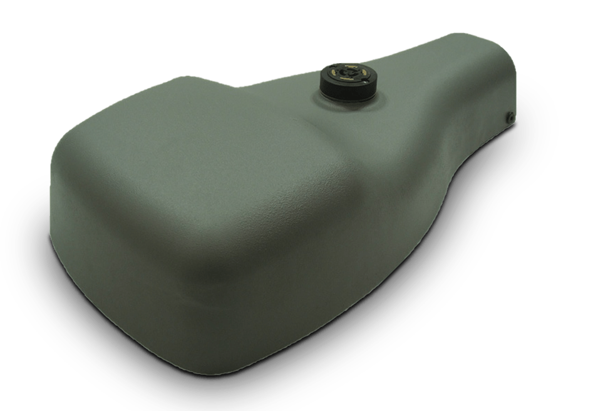
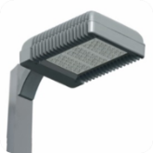
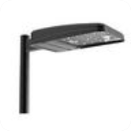
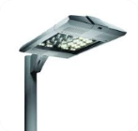
ASTROPHILE SERIES PRODUCT COMPARISON
Hubbell LED street light
NBA LED - varies from
586 to 590nm
18 lumens per watt
Beacon LED street light
NBA LED - varies
586 to 590nm
24 lumens per watt
Kim Lighting
NBA LED - 580nm
27 lumens per watt
CROSSROADS LED ASTROPHILE SERIES
AVAILABLE IN PEAK DOMINANT WAVELENGTHS
OF 589, 592 AND 595NM
66 LUMENS PER WATT

Slide 11
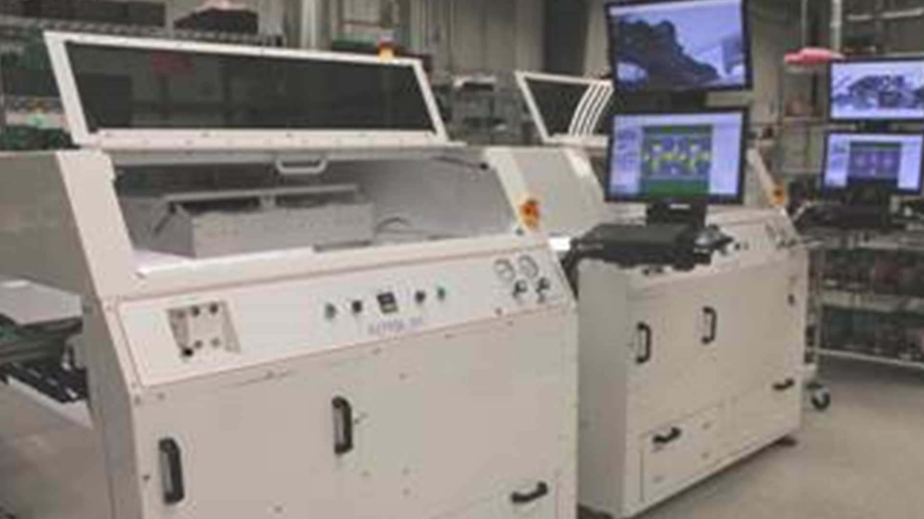
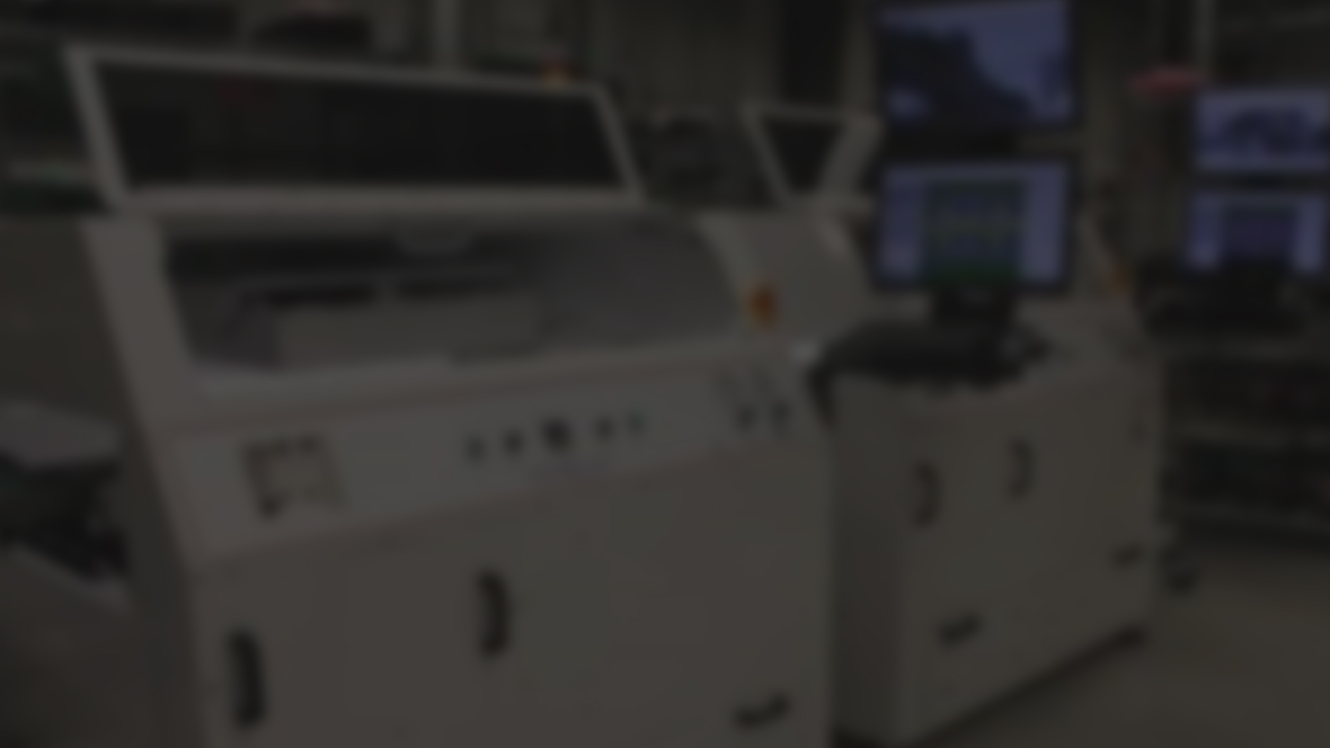
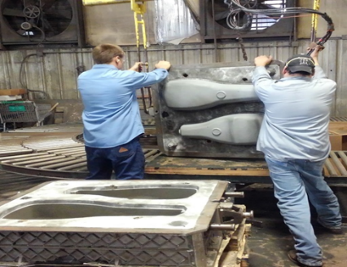
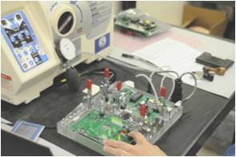
AMERICAN MADE LED LUMINAIRES
All aluminum fixture housings and electronics 100% designed and manufactured in the USA
Fully rated and certified facilities
Rigorous Quality Control testing procedures
Luminaires thoroughly tested by independent third-party photometric laboratories
Available through both factory-direct and distribution

Slide 12
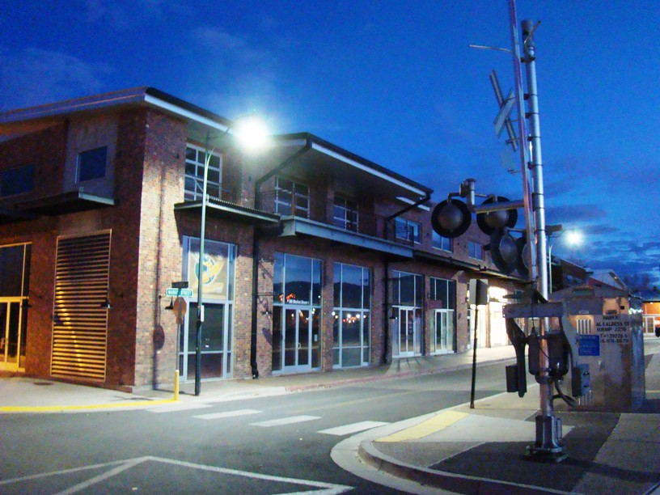
WHY CHOOSE
CROSSROADS LED?
Unlike other LED companies, Crossroads LED is committed to leading the industry in performance, dependability and cost savings solutions by …
Designing new dark sky compliant fixtures that will meet all lighting specifications;
Delivering the highest light output and reliability rating in the industry;
Providing independent test data to verify luminaire performance;
Offering direct sales options to cities and municipalities;
Manufacturing the only future-proof LED lighting fixture on the market today.
SUCCESSFUL LIGHTING PROJECTS BEGIN AND END WITH

Slide 13

Notes:
Required Slide

